Slide 1

Software Development Project (SWP391)
STUDENT Guides

Slide 2
Subject Overview
Target: students to work in teams, to complete a specific software Web system (recommend to be a management system)
  Team: 4-5 students/teams, as assigned or arranged by the teacher
  Product topic & scope: as provided/agreed with the teacher.
  Process/software development scope: requirement analysing, designing, coding, and integrating.
Tools & Technologies:
Sources & Task/Issue Management: GitLab, login with FPT email account,
Document/Files Management: OneDrive, login with the FPT email account
Student/Teacher communication: Slack, login with the FPT account
Mailing Tool: integrate with the MailTrap (https://mailtrap.io)
Development techniques & environment: choose Java or .NET technologies (with the technical framework & DBMS as assigned/agreed by the teacher)
  For Java project
  Java servlet (Không dùng framework)
  • Java JDK version 1.6 or higher, NetBeans 13
  • Recommended DBMS: MySQL Server (v8.0.23 or higher), MySQL Workbench;
  For .NET project (not recommended)
  • Microsoft Visual Studio version 2015 or higher
  • Microsoft Internet Information Services server (come with Microsoft Windows)
  • Recommended DBMS: Microsoft SQL Server version 2014 or higher (Express version)

Slide 3
Inputs & Requirements
Templates & guides: the latest ones as in classroom
Project requirement documents, as prepared /provided by the guiding teacher or as proposed by the student team with agreement and/or adjustment from the teacher
  Acceptable product size: there are enough functions or screens so that each team member can have 3-4 different screens/functions to implement in each iteration (including the iteration 3)
  Input requirement: to be agreed/assigned by the teacher
  Refs: CMS (SWP391 General Information)

Slide 4
Milestones & Evaluations
# | Milestone | Duration (#slot 135’) | Duration (#slot 90’) | Eval Weight | Notes
1 | Iteration 1 | 4 | 9 | 15% | Assessment 1 (Week3)Milestone 1: Requirement Analysis & Design
2 | Iteration 2 | 8 | 9 | 20%
3 | Iteration 3 | 8 | 9 | 25%
4 | Final Presentation | 2 | 3 | 40% | Final presentation with the with the joining of 2 teachers as evaluators
To pass the subject, student needs to have
  Present >=80% of training slots
  OG Grade >= 5/10;
  OG Grade=(iter1*15% + iter2*20%+ iter3*25%] / 60%
  Final Presentation Grade >= 5/10; evaluate the iter3 results
  No cheating found

Slide 5
Milestones & Evaluations
Main student & teacher tasks
The teacher:
The teacher is acting as both the coach/mentor and the customer/PO for the student teams: the final point to confirm/clarify team’s requirements
In the initiation stage, the teacher would
  Introduce the subject, arrange the student teams, assign/verify the input requirements
  Create Slack chatting channel, invite all the students into, and then post the input requirements and other reference materials/links into
  Create GitLab group and configure the group labels (issue types, detailed statuses), and milestones
  Create GitLab repositories and invite team leaders as the maintainer; The team leader is then invite their team members into and configure the repository security settings
  Guides the students on: GitLab (source code versioning control and project tasks/issues tracking) + Slack with related communication rules..
  Clarify requirement and guide students to complete the submit packages
Most of the teacher time during the project iterations is to clarify/confirm requirements and evaluate/feedback on student work results
The student:
For the planned/assigned functions/screens: log & track the tasks/issues, complete detailed documentation, full stack coding.
Work together to complete the common code modules, database tables design, common document contents + review and integrate the works with others

Slide 6
Milestones & Evaluations
Iteration Submit Items
By the end of each iteration, student teams are requested to submit following outputs
Project Tracking document which include
  The updated product scopes tracking: sheets “Use Cases” and “Product” (screens)
  The status of functions/screens that the team has implemented in the iteration
  The planned/assigned functions/screens for the next iteration
  Notes: the initial list of product scopes & planned/assigned screens/functions for the iteration 1 (iter1) need to be submitted before the start of the iter1.
RDS document: include the detailed requirement and design specifications for the iterations and the updates for the previous iterations (if any).
Links to related released materials:
  Links to each team member’s demonstration videos
  Links to the tagged iteration’s source codes on the GitLab; the iteration’s DB scripts & other source/config materials if any need to be added to this tagged codes.

Slide 7
Iter 1
1. Requirement Overview (50%)
- Context Diagram
- Main Business Processes (Workflow)
- Use Case Diagrams
- System Functionalities:
+ Screen Flow
+ Screen Authorization
+ Non-UI Functions
- Entity Relatioship Diagram
- Stage Transition Diagrams
2. Functional Requirements
- Screen Mockups
- Screen-UC Mappings
3. Design (30%)
4. LogAI, report weekly (20%)

Slide 8
Milestones & Evaluations
Evaluation Criteria – iter 2 and 3
For ongoing assessment, the class teacher would grade the iteration result with below two criteria
  LOC (Line of Codes): weight 50%, evaluate individually, as sum of converted LOCs for all the functions/screens that each team member has completed in the iteration (with the iteration 3, we evaluate all the completed screens/functions)
    Converted LOC of a function/screen = C * Q, in which
    C is Complexity, graded by the teacher (next slides)
    Q is Quality, graded based on the quality of the screen (completeness, correctness, good UI/UX,..)
      High Quality: 100%
      Medium Quality: 75%
      Low Quality: 50%
    LOC Grade = Converted LOC * 10/MaxLOC (MaxLOC = 330 for iter2, 660 for iter3)
  Submitted Package: weight 30%, evaluation for the source code, DB script, and the RDS (Requirement & Design Specification) document.
  - weight 20% for (1. AI Logs: each member >=5 logs for coding & debugging
  2. Git commits: each members >= 8 code commits
  3. Weekly Reports: each member >=3 reports)
Final presentation: evaluated by 2 teachers (other than the class teacher)
  LOC Grade = Converted LOC * 10/660 (all screens/functions)
  Submitted software package/documents
  Final product presentation

Slide 9
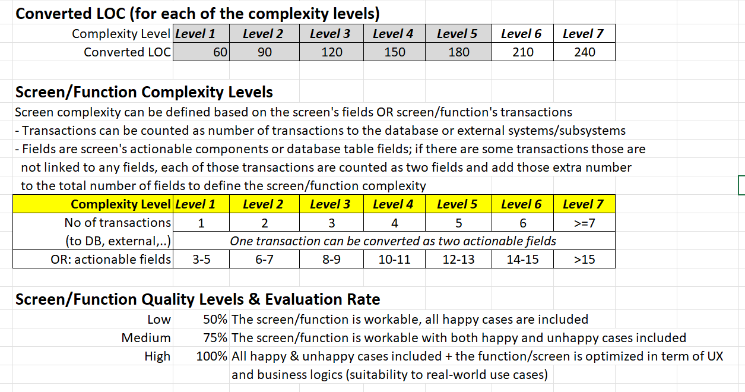

Slide 10
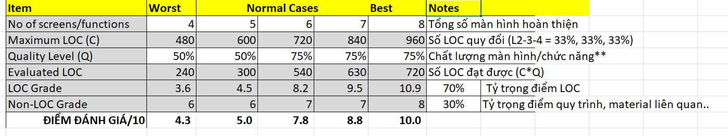

Slide 11
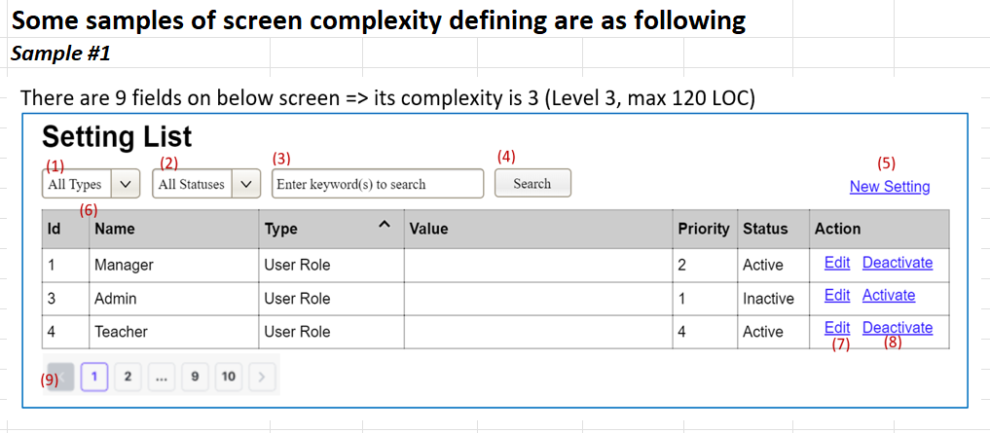

Slide 12
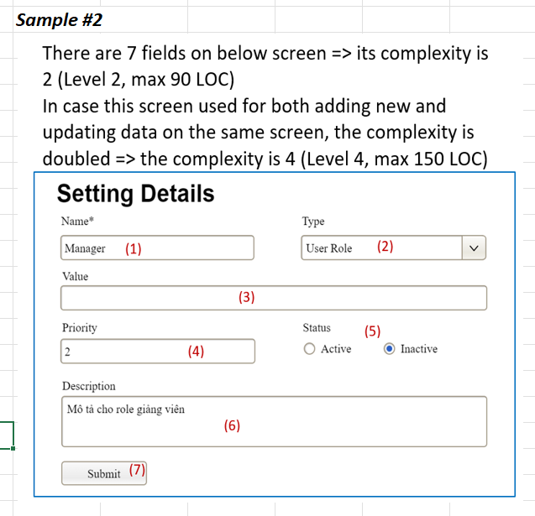

Slide 13
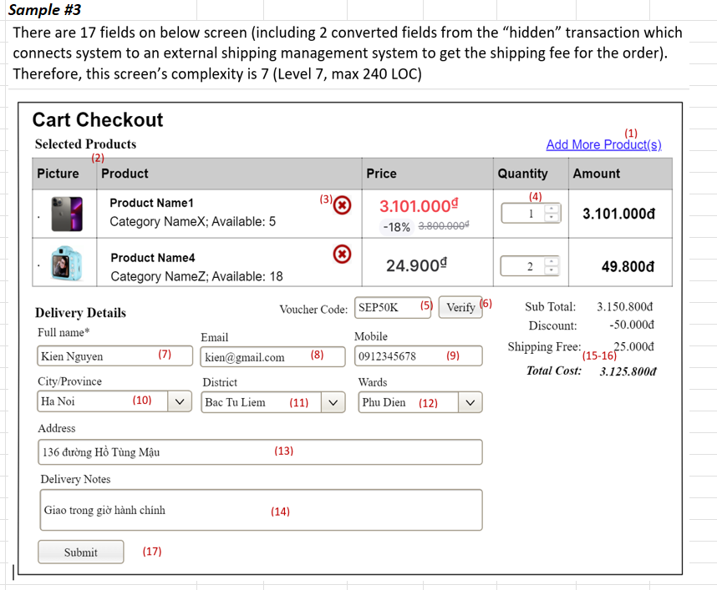

Slide 14
Git Guides
Thiết lập môi trường
Team lead invite team members..
Google login với tài khoản FPT, sau đó thiết lập mật khẩu đăng nhập
Create working folder
Chạy cmd và chuyển vào thư mục vừa tạo
Chạy lệnh khởi tạo local git: git init
Kết nối đến link dự án: git remote add origin https://gitlab.com/fuhn/kien/java-utils.git
Nhập email/pass để đăng nhập (trong PopUp)
Lấy cấu trúc/codes mới nhất: git pull origin main

Slide 15
Git Guides
Cập nhật, thêm mới,..
Lấy codes mới nhất về: git pull origin main
Thêm hoặc sửa các file codes (NetBeans 13)
Check code đảm bảo dịch, chạy ko lỗi
Gọi lệnh: git add .
Gọi: git commit –m “mô tả thay đổi của bạn”
Gọi: git push --set-upstream origin main

Slide 16
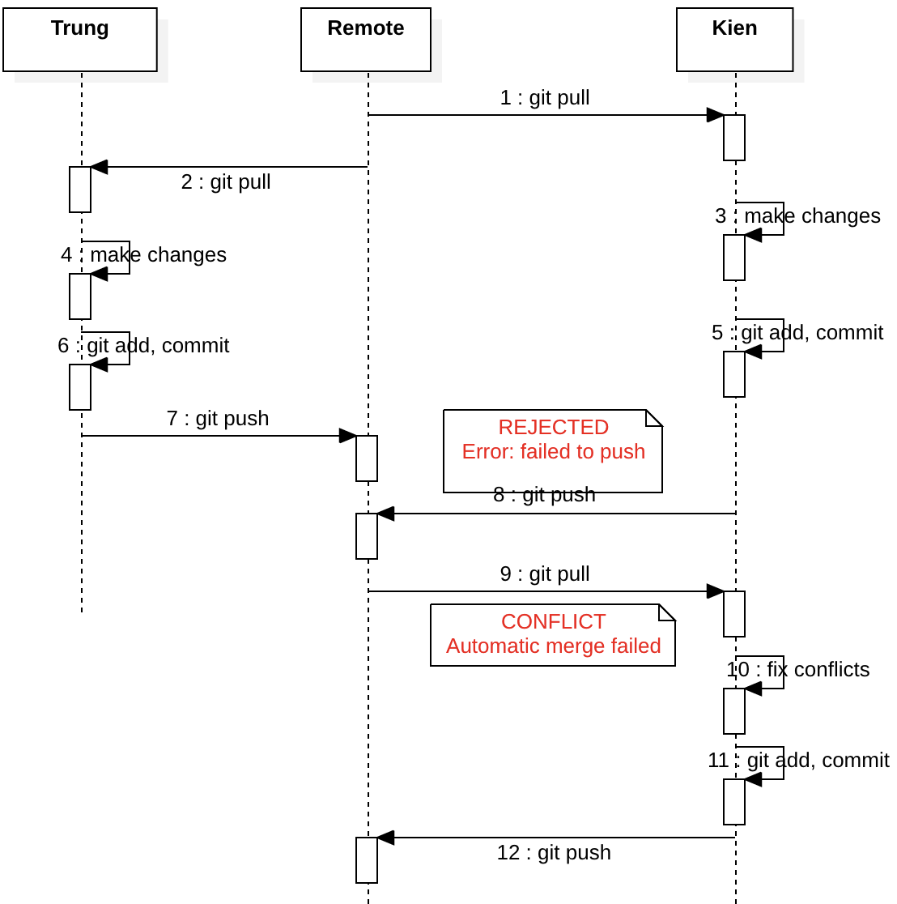
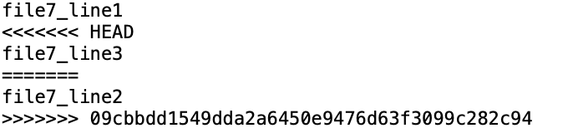
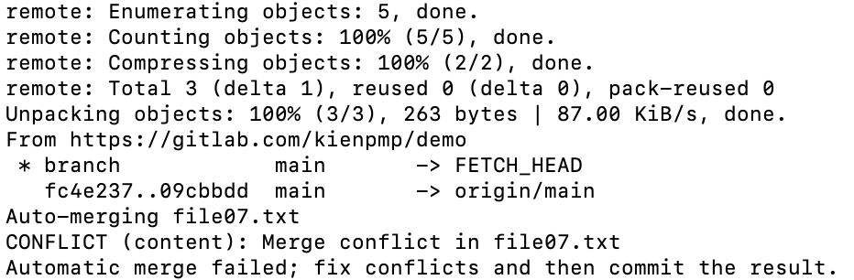
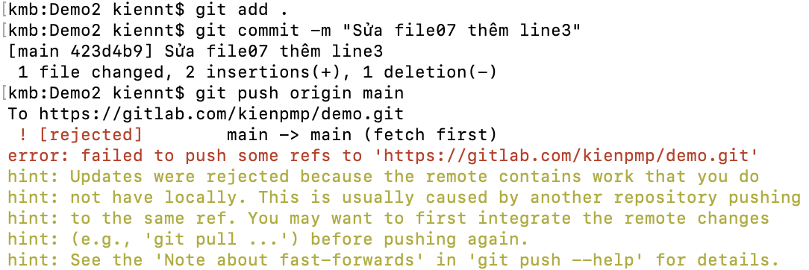
Git Guides
Xử lý xung đột 1/2
Change conflics occured when two developers (Trung, Kien) changed the same based file(s) and push at the different point of time..
The changes from 2 developers are merged into file like this. Next steps is to change the content -> add -> commit -> push...
After pull lastest codes from Remote
Failed to push
Notes:
An: add “file7_line2” và push trước
Bình: add “file7_line3” và push sau, khi đó gặp xung đột code và cần phải xử lý

Slide 17
Git Guides
Xử lý xung đột 2/2
Sau khi gọi lệnh push ở slide trước gặp lỗi báo có xung đột code
git pull origin main
Sửa lại các nội dung file bị xung đột (merge thủ công)
git add .
git commit –m “mô tả…”
git push origin main

Slide 18
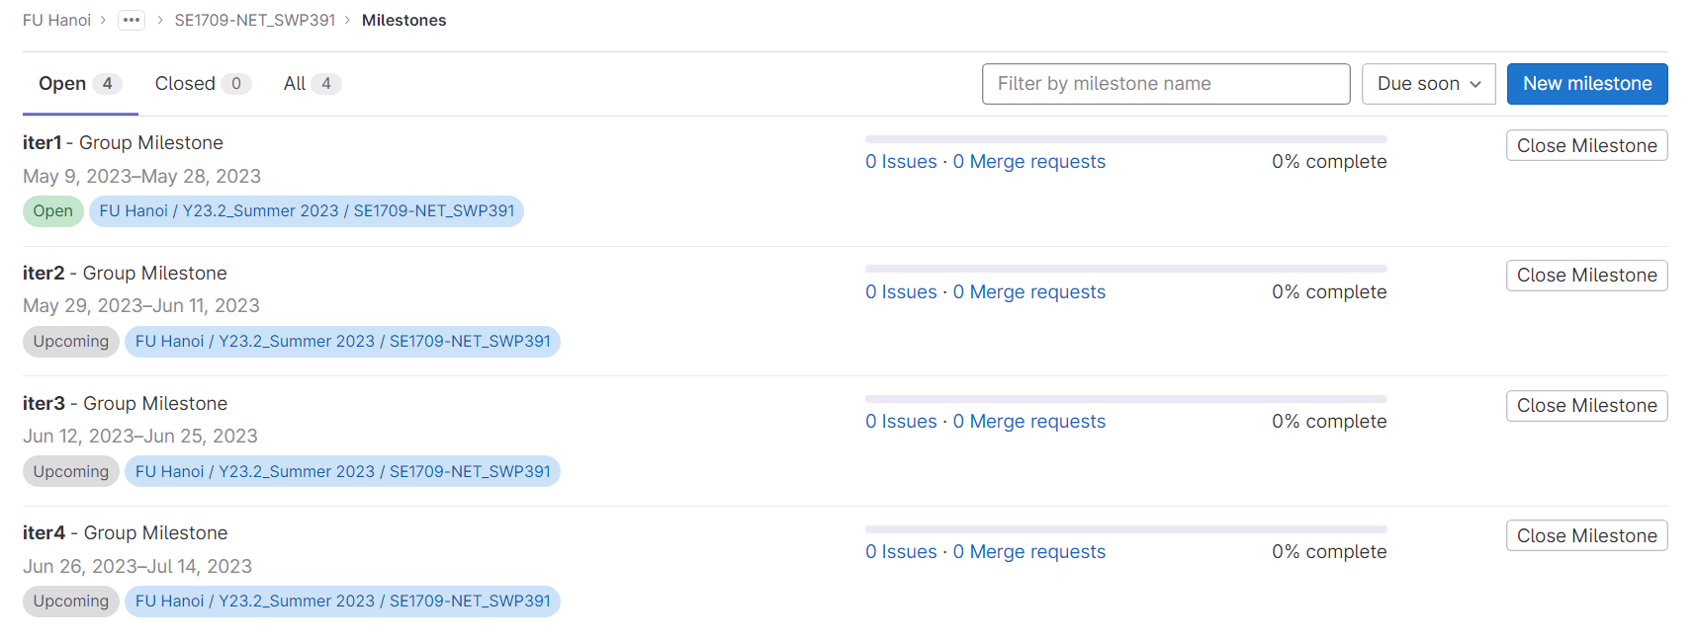
Tracking & Monitoring
Project milestones

Slide 19
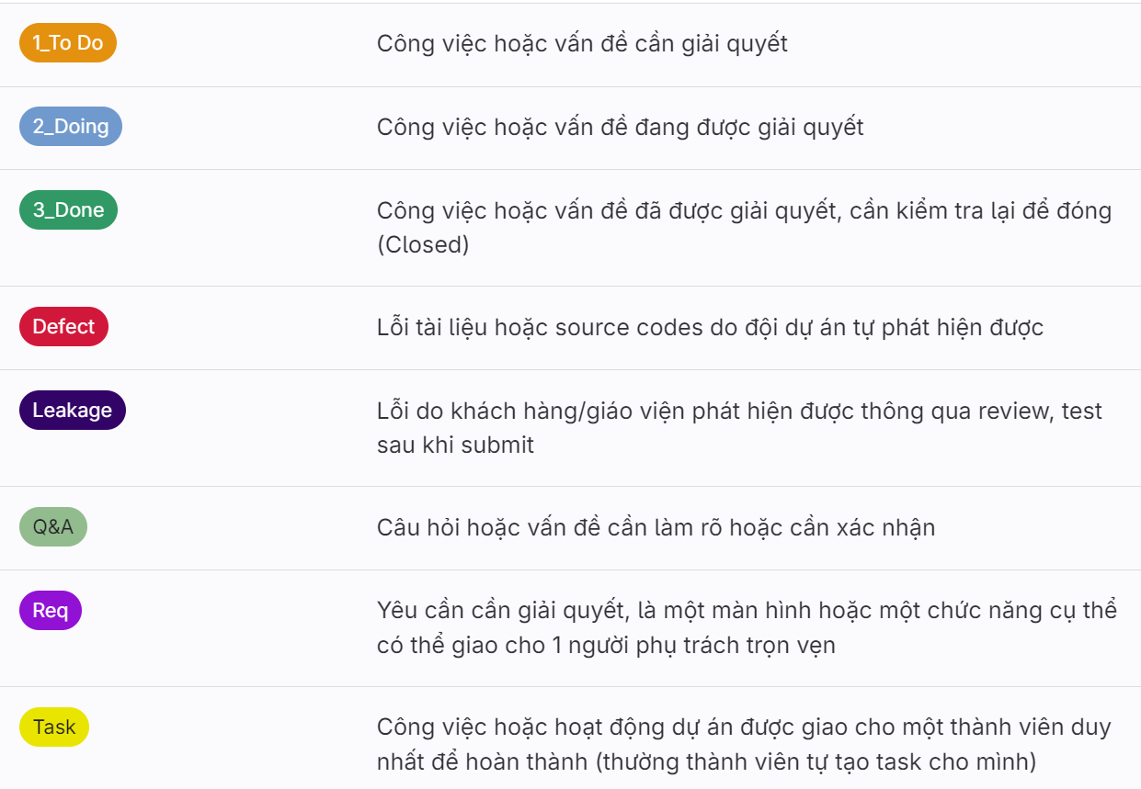
Tracking & Monitoring
Track issue type/status with labels
Notes:
1_To Do: Công việc hoặc vấn đề cần giải quyết
2_Doing: Công việc hoặc vấn đề đang được giải quyết
3_Done: Công việc hoặc vấn đề đã được giải quyết, cần kiểm tra lại để đóng (Closed)
Defect: Lỗi tài liệu hoặc source codes do đội dự án tự phát hiện được
Leakage: Lỗi do khách hàng/giáo viện phát hiện được thông qua review, test sau khi submit
Q&A: Câu hỏi hoặc vấn đề cần làm rõ hoặc cần xác nhận
Req: Yêu cần cần giải quyết, là một màn hình hoặc một chức năng cụ thể có thể giao cho 1 người phụ trách trọn vẹn
Task: Công việc hoặc hoạt động dự án được giao cho một thành viên duy nhất để hoàn thành (thường thành viên tự tạo task cho mình)

Slide 20
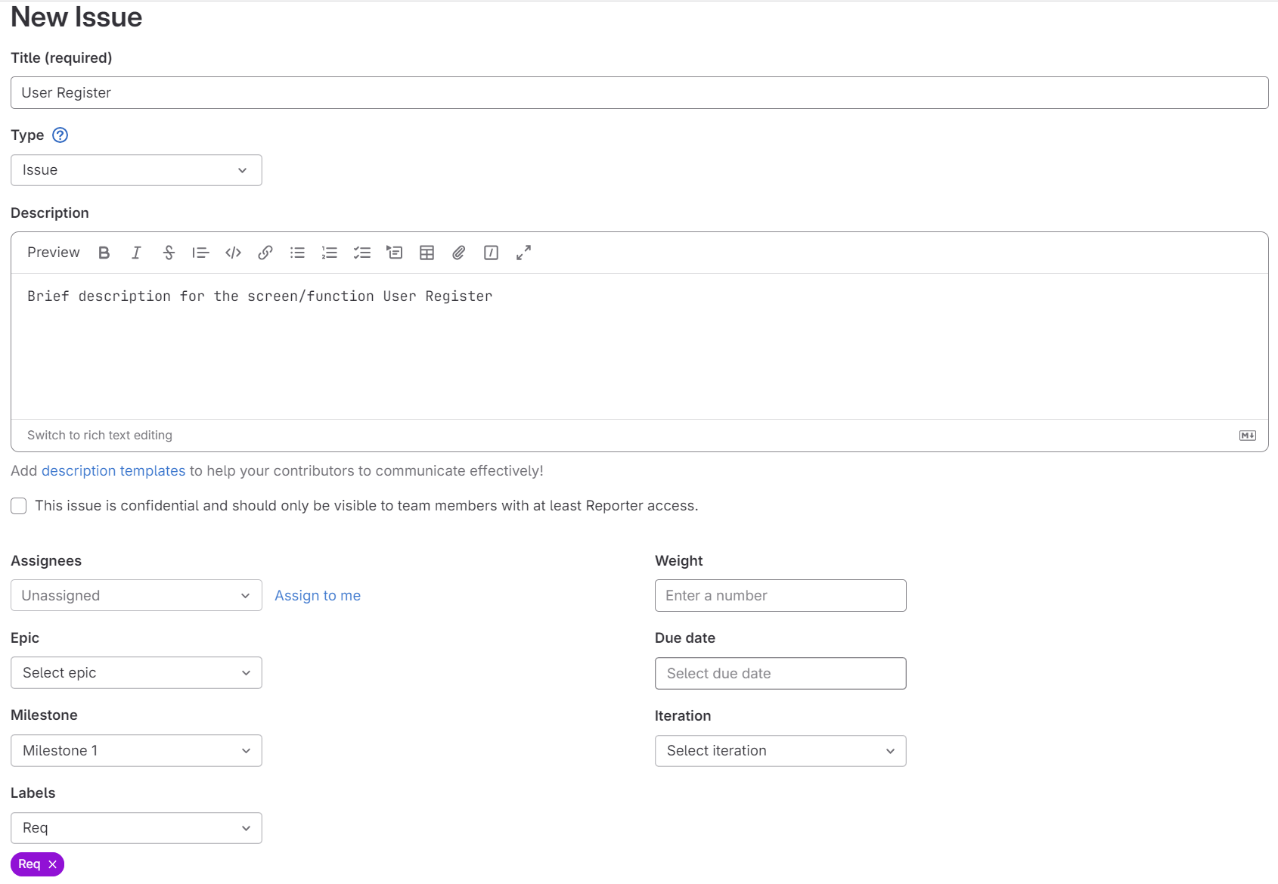
Tracking & Monitoring
Manage project issues 1/4
New Req (Issues/List/New Issue)

Slide 21
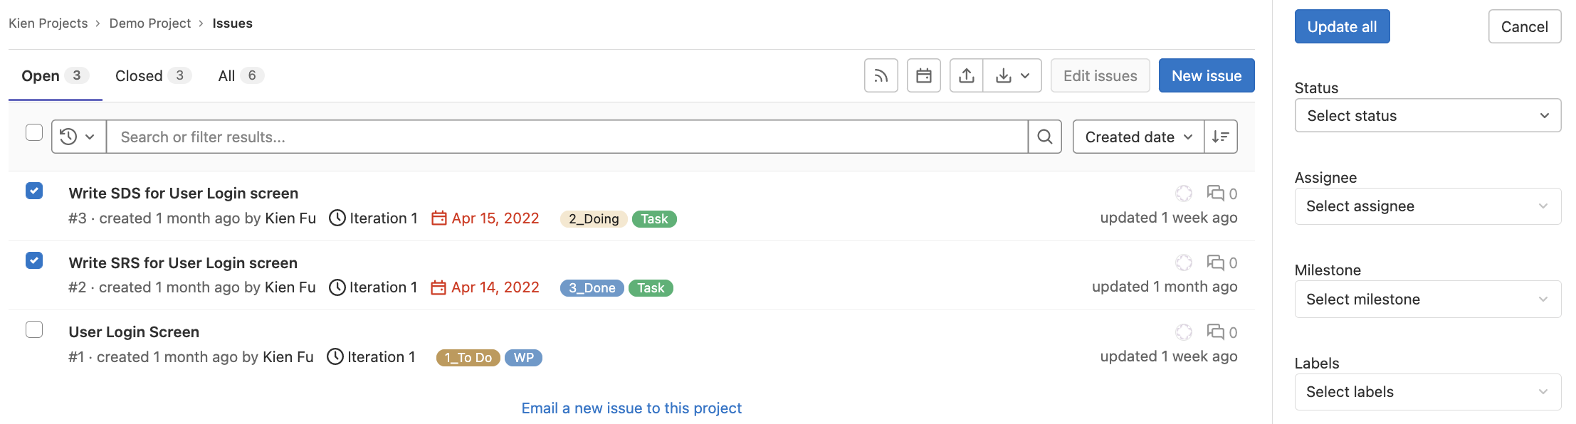
Tracking & Monitoring
Manage project issues 2/4
Issues List (Issues/List)
From this page, user canimport issues, search/filter then export issues or select issue(s) for multiple editing

Slide 22
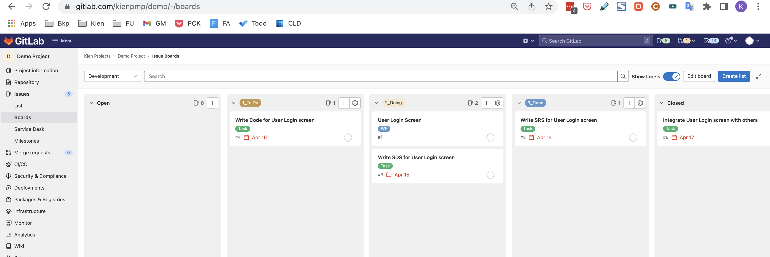
Tracking & Monitoring
Manage project issues 3/4
Issues Board (Issues/Board)
Project team to track issues for their project team mapped with relevant issue type & status (Board view)
From this page, the project member can:
  Filter the issues by Assignee, Label, Milestone,..
  Quickly create new issue at a specific status (issue list)
  Drag & drop issues to change the status & priority of the issue

Slide 23
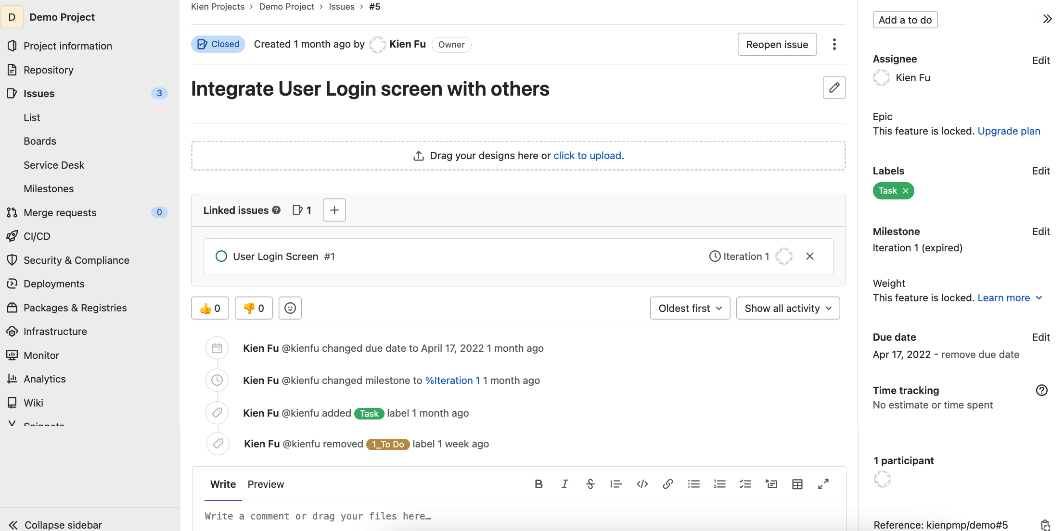
Tracking & Monitoring
Manage project issues 4/4
Issue Details (Issues/List/Issue Details)
View details of a specific issue, from that to view change history/comments, link issues, quickly edit issue attributes & give the comments..

Slide 24
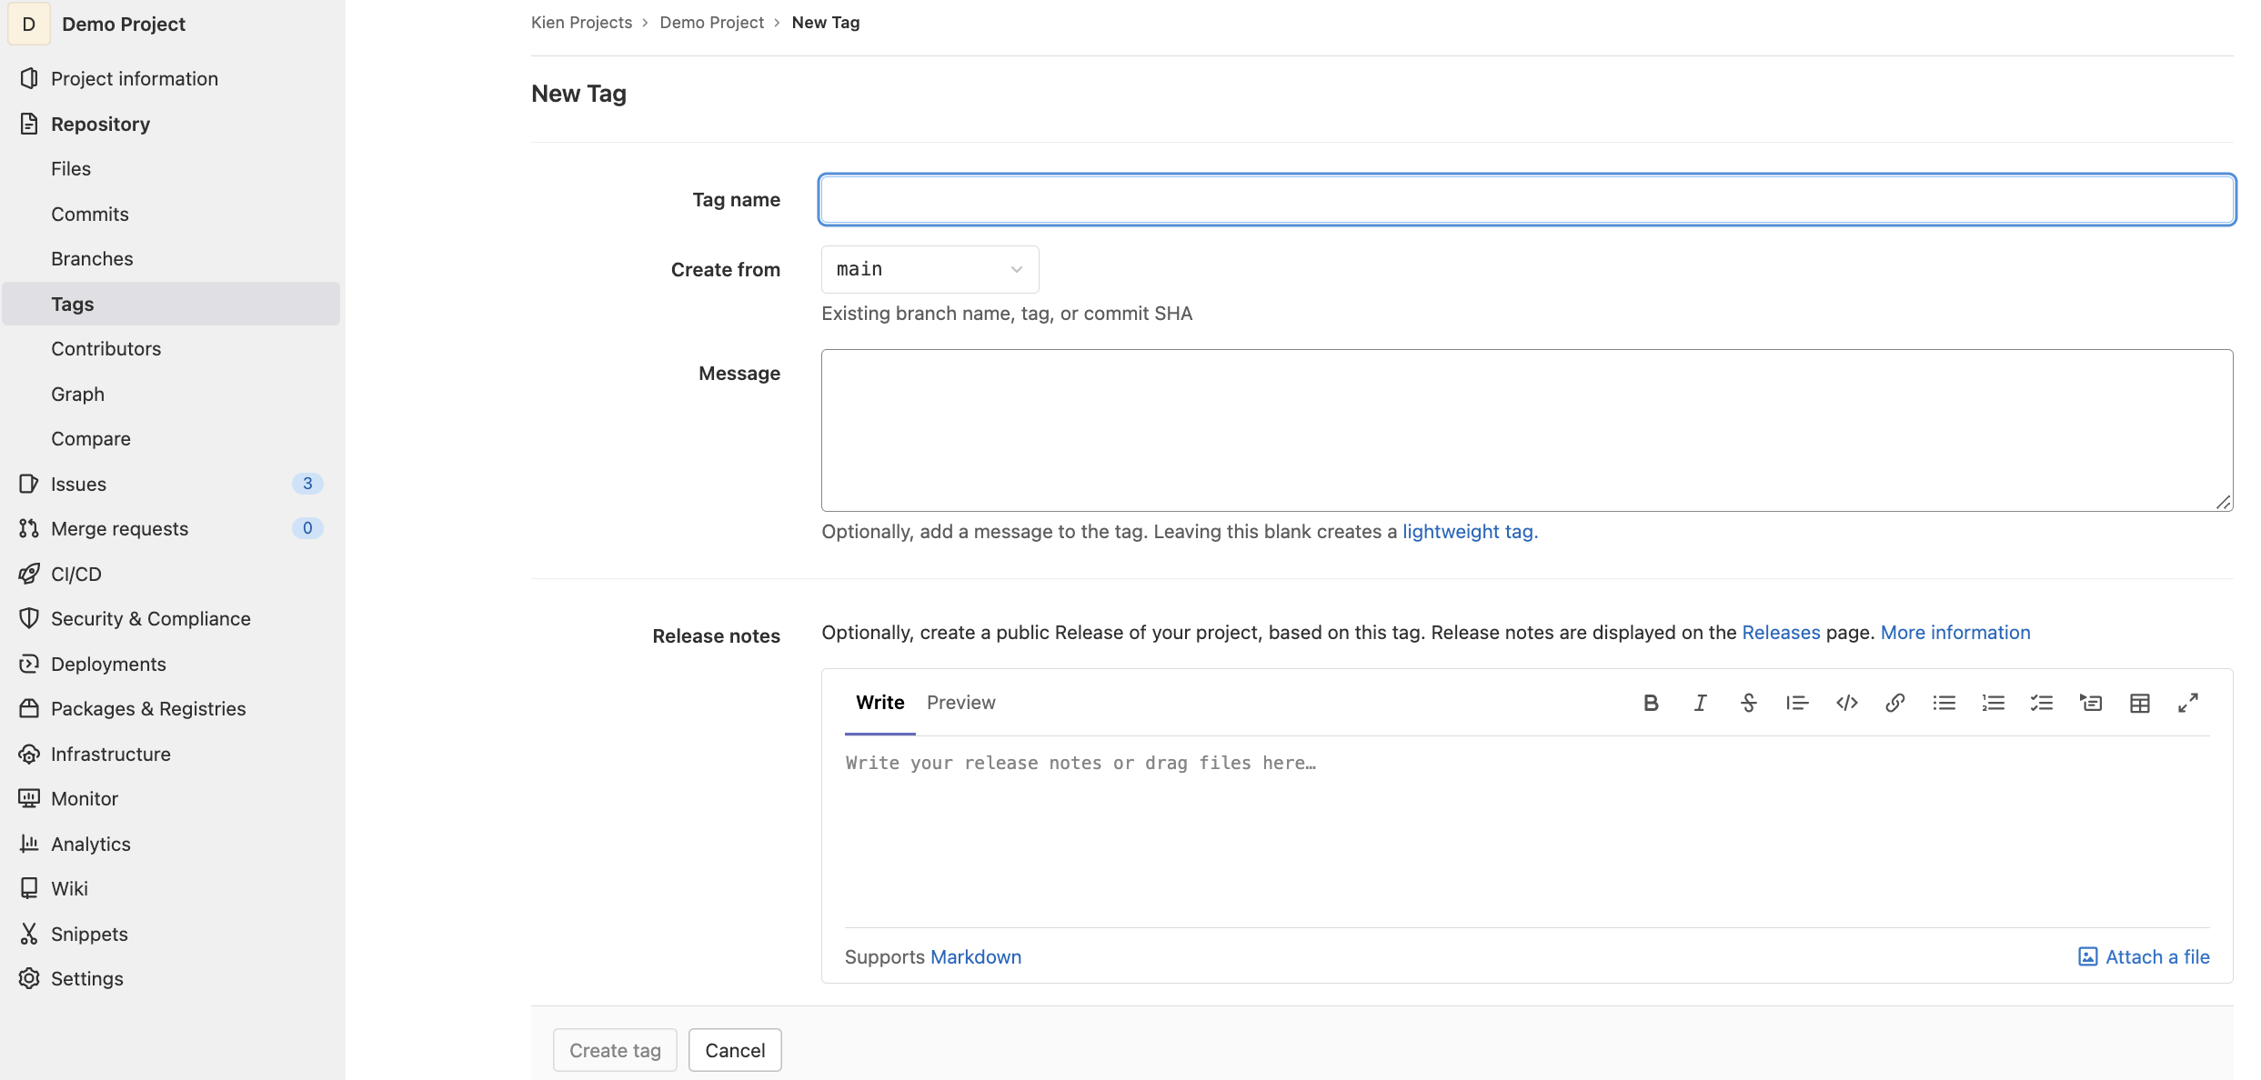
Tracking & Monitoring
Manage git tags
New Tag (Project Information/Repository/Tags)
On viewing details of a tag, you can:
Copy tag URL from address bar for sharing
Attach files or change attached files for the tag

Slide 25


